Slide 1


Slide 2

JAVASCRIPT BASIC PROGRAMMING CONCEPT

Slide 3
Today’s Agenda
JavaScript Embedding
Writing To The Document
Using Browser Console
Comments In JavaScript

Slide 4
JavaScript Embedding
JavaScript can be embedded in HTML page in 2 ways
1
2
Locally
Externally

Slide 5
Local JavaScript Embedding
To insert a JavaScript into an HTML page, use the <script> tag.
The <script> and </script> tells where the JavaScript starts and ends.
<script>
// javascript code
</script>

Slide 6
Local JavaScript Examples
<html>
<head>
<script>
// javascript code
</script>
</head>
<body>
. . . .
</body>
</html>
<html>
<head>. . . </head>
<body>
. . . .
<script>
// javascript code
</script>
</body>
</html>

Slide 7
Where to embed <script> tag ?
Head
Body

If we want to run the <script> before page
loads then it is kept in the <head> section.

If we want to run the <script> after the page
loads so that it can interact with HTML
elements then it is kept in the <body> section.

Slide 8
External JavaScript Embedding
When the same code is used in many different web pages we use external JavaScript
Put the name of the script file in the src (source) attribute of a <script> tag
<html>
<head>
<script src=“javascript file” >
</script>
</head>
.
.

Slide 9
External JavaScript Example
<html>
<head>
<script type=“text/javascript” src=“myfile.js” >
</script>
</head>
<body>
</body>
</html>

Slide 10
Introduction To document Object
JS provides us many predefined objects like window, document, console, Math etc
Amongst all of them the document object is the most commonly used .
It represents the current page and has a method called write() .
This method allows us to print the specified text to the page.
Syntax:
document.write(‘text to display’);
OR
document.write(“text to display”);

Slide 11
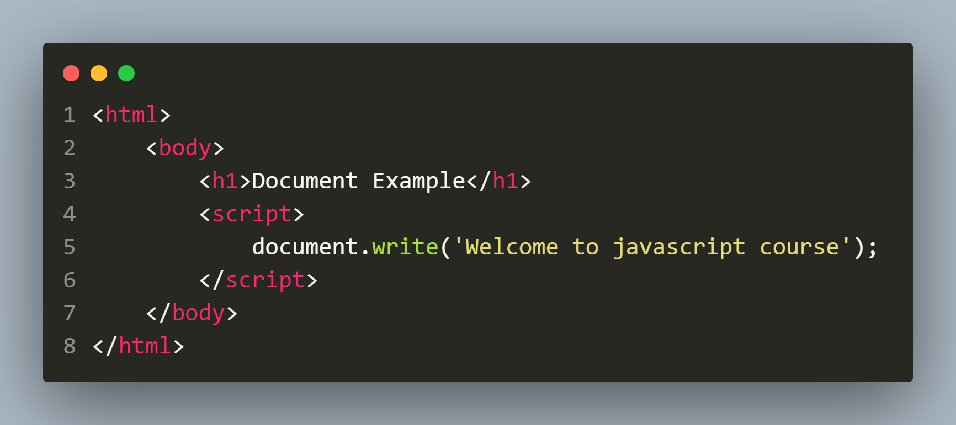
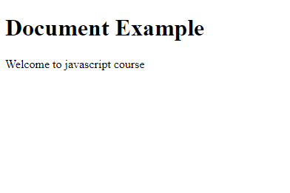
Example
Code
Output

Slide 12
Embedding HTML
The text outputted using document.write( ) statement can
contain HTML tags also.
The browser processes them in the same way like it processes html tags in a regular HTML page.

Slide 13
Special Note
Any document.write( ) statement that runs after the page finishes loading will create a new page and overwrite all of the content of the current page.

Slide 14
Comments In JavaScript
Single line comment
Multi line comment
Syntax:
// javascript code
Syntax:
/* javascript code
javascript code */

Slide 15
Using console Object
JS provides us another object called console
It represents the browser’s console window and has a method called log()
This method allows us to print the specified text to the console window.
Syntax:
console.log(‘text to display’);

